Slide 1
VEHICULAR ADHOC ROUTING SCHEME
GUIDE: Prof.RahulNath
Julie T Alex

Slide 2
CONTENTS:
INTRODUCTION
REVIEW OF LITERATURE
METHODOLOGIES
PROPOSED SYSTEM
CONCLUSION
REFERENCES

Slide 3
INTRODUCTION
SWARM INTELLIGENCE is a collective behaviour of decentralised ,self organised systems,natural or artificial.
There are different swarm intelligence alogirithms
Altruism algorithm ...
Ant colony optimization ...
Artificial bee colony algorithm ...
Is a part of AI: an area of science that emphasis the creation of intelligent machines that works like humans.

Slide 4


SWARM INTELLIGENCE

Slide 5
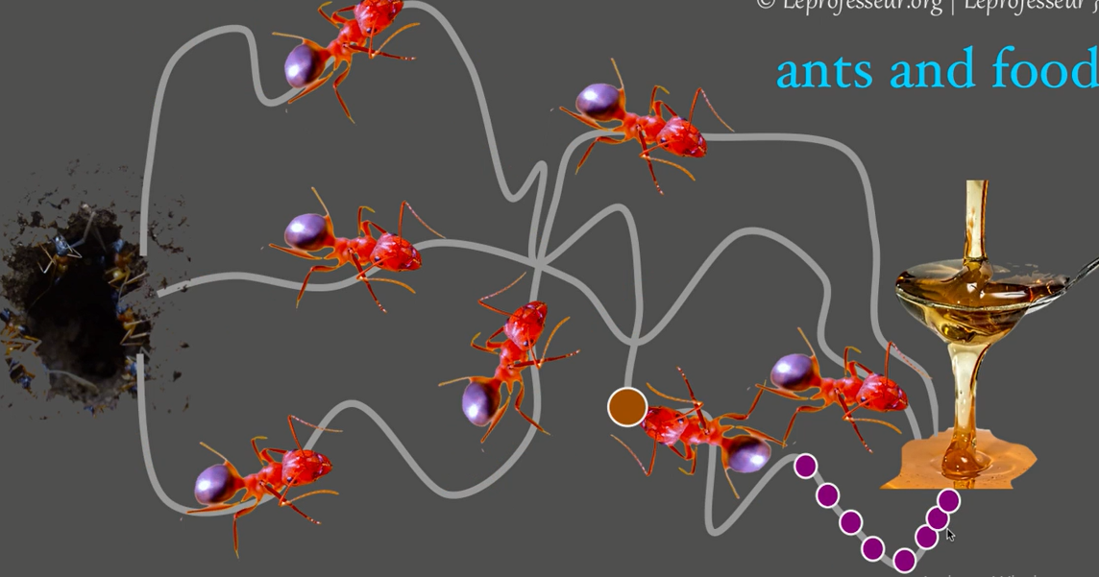
Ant Colony Optimization(ACO)

Slide 6
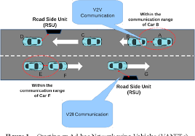
VANET
Is a subform of MANET
Establishes communication among nearby vehicles .
Provides high mobility
Rapidly changing network topology

Slide 7
REVIEW OF LITERATURE:
Wei Luo and Et al.. --------- [1]
Improved ACO
Yongjun Sun and Et al.. ----------[2]
improved routing algorithm based on ACO
Felipe Cunha and Et al.. -----------[3]
Datacommunnication in VANETs
Elias Khozha and Et al.. ------------[4]
ACOHRP to improve the efficiency and reliability of vehicle traffic information message transmission.

Slide 8
METHODOLOGIES:
Simulation using NS2 Simulators in system of
Processor: Intel( R) Pentium (R) CPU B960 @2.20 GHz
RAM :4.00GB
System type : 64bit OS

Slide 9
PROPOSED SYSTEM:
PRIMARY OBJECTIVE
Develop bee colony optimisation for vehicular ad hoc network
SECONDARY OBJECTIVE
compare it with the existing one

Slide 10
CONCLUSION
Through this project work Iam trying to implement swam intelligence in Vanets.

Slide 11
REFERENCES.
[1] An improved Ant colony optimisation and its application on tsp
[2] An improved Routing algorithm bsed on ant colony optimisation in WSN
[3] Data communication in VANETS

